Slide 1

WEB SCRAPING TO PYMYSQL
MADHURI GUPTA
DA/DS BATCH 28

Slide 2
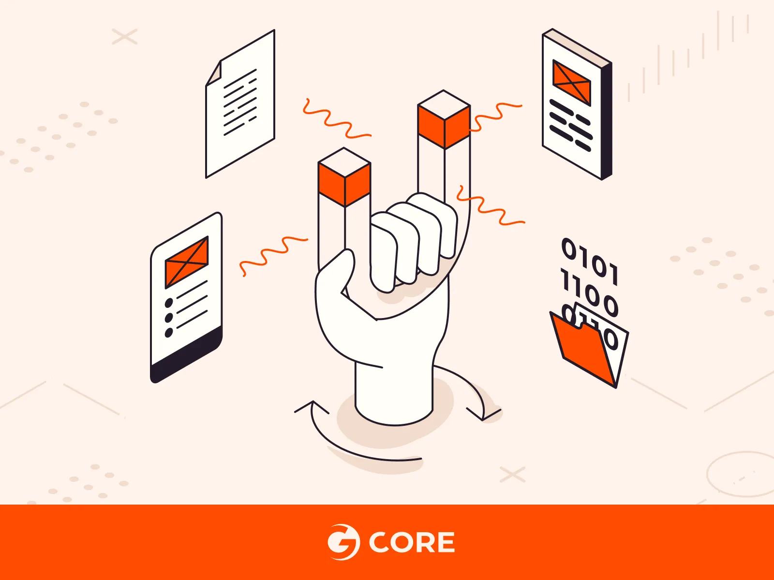
Introduction
web scraping data from a website and storing it in a MySQL database using Pymysql. The goal is to automate the data extraction process and make it accessible for analysis and reporting.

Slide 3
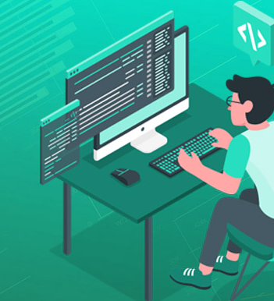
OBJECTIVE
Extract specific data from a website.
Store the scraped data in a MySQL database.
Insert the data frame into a MySQL table.
Filter the data for specific Movies
And perform data visualisation for that data.

Slide 4

WEB SCRAPING
Web scraping is the technique of automatically extracting information from websites. It involves writing code or using tools to load web pages, access their HTML structure, and collect specific data, such as text, images, or links. This data can then be stored in a structured format like a database or a file for further analysis or use.

Slide 5
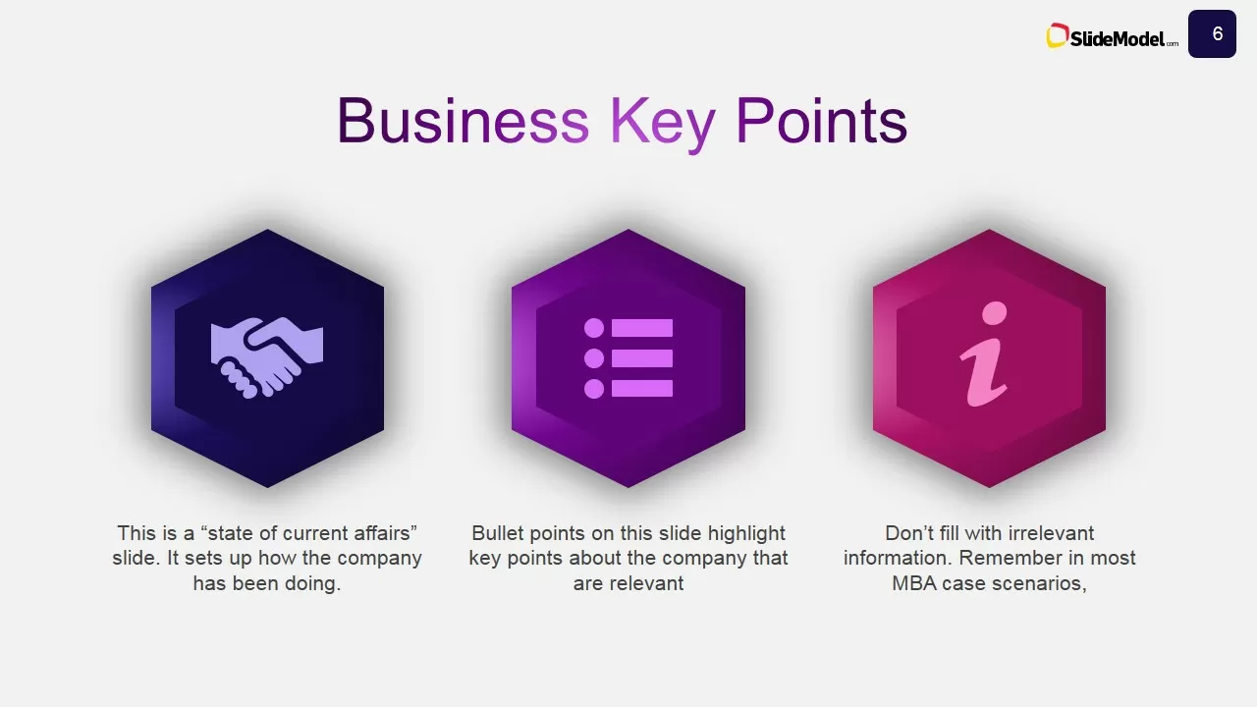
Key Points:
Automation: Web scraping allows for the collection of large amounts of data quickly and efficiently, which would be time-consuming to do manually.
Tools and Libraries: Common tools include Python's BeautifulSoup, Scrapy, Selenium, and requests. These help in navigating web pages and extracting content.
Use Cases: It’s often used for market research, price monitoring, data mining, and content aggregation.
Legal Considerations: Always check a website’s robots.txt file and terms of service to ensure your scraping activities are permitted.
In essence, web scraping is a powerful tool for gathering data from the web for various applications.

Slide 6
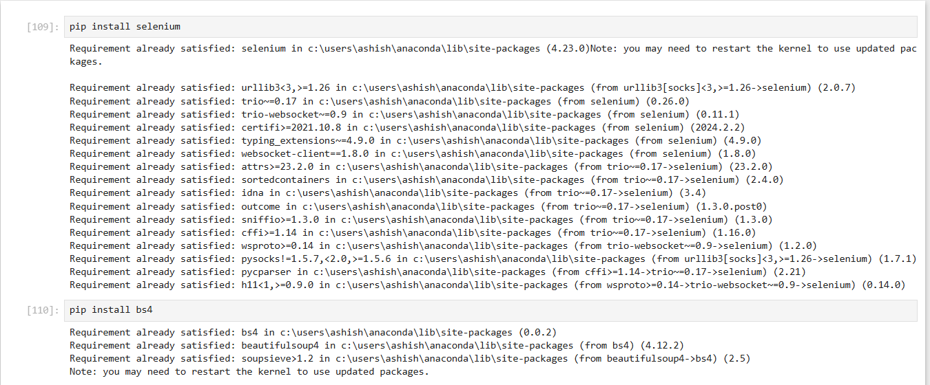
INSTALING SELENIUM AND BS4
Online store and market swap

Slide 7
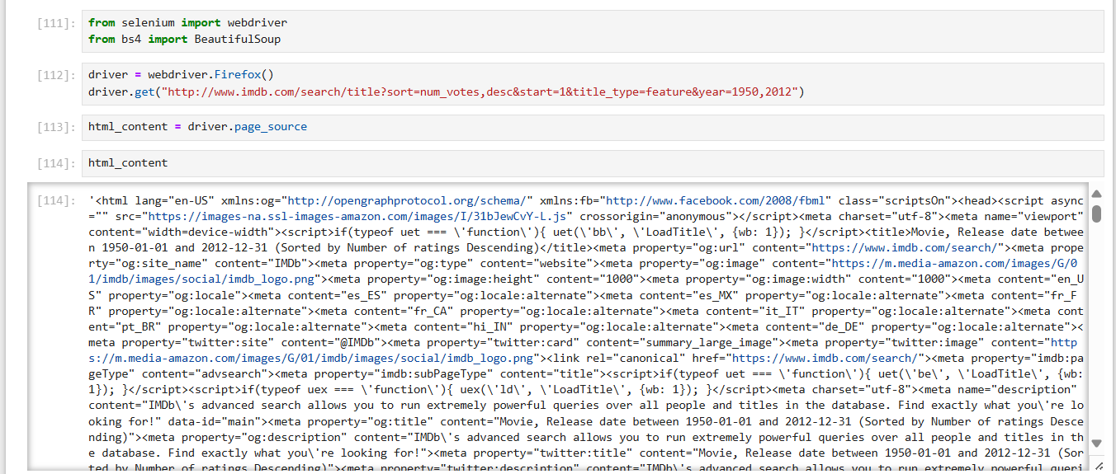
IMPORTING WEBDRIVER AND BEAUTIFULSOUP

Slide 8
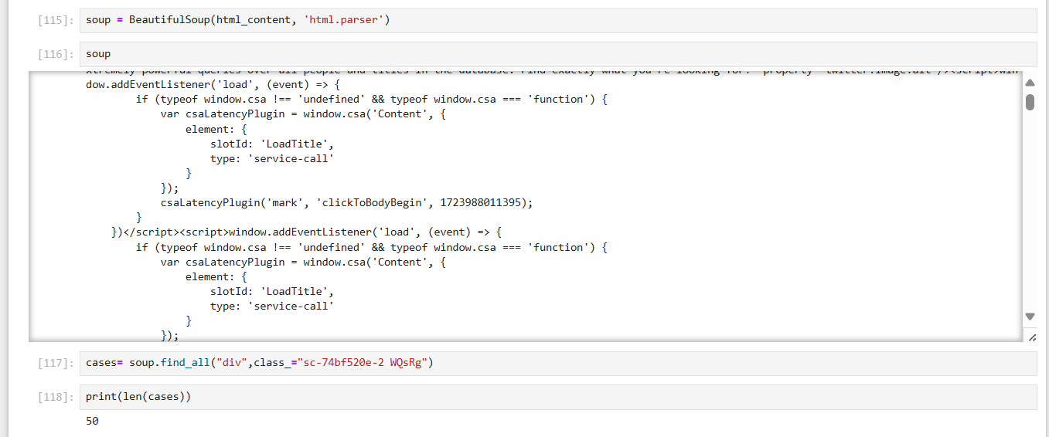
BeautifulSoup is a powerful and widely used tool in web scraping for parsing HTML and extracting data from web pages

Slide 9
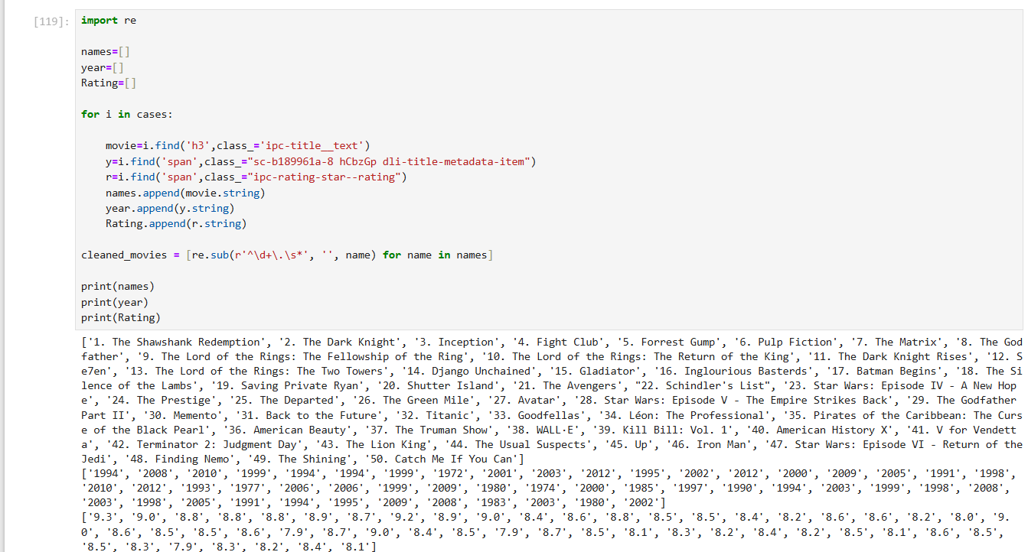
Extracting data typically refers to the process of retrieving specific information from a larger dataset or source, such as a website, database, or document.

Slide 10

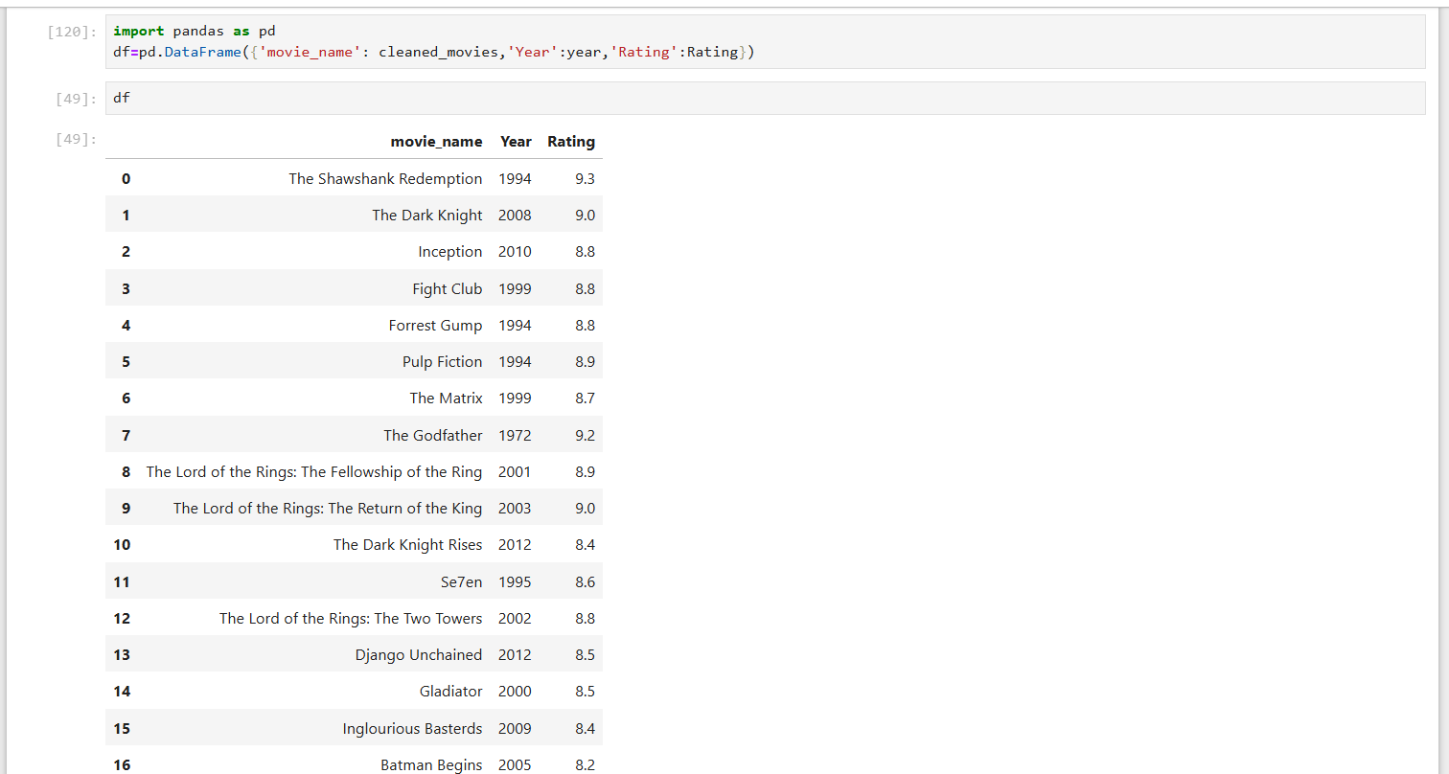
IMPORTING MOVIE NAME YEAR AND RATING FROM SITE
Opportunity to build
Fully inclusive market
Total addressable market
Freedom to invent
Selectively inclusive market
Serviceable available market
 | Clients | Orders | Gross revenue | Net revenue
20XX | 10 | 1100 | $10,000 | $7,000
20XX | 20 | 200 | $20,000 | $16,000
20XX | 30 | 300 | $30,000 | $25,000
20XX | 40 | 400 | $40,000 | $30,000

Slide 11

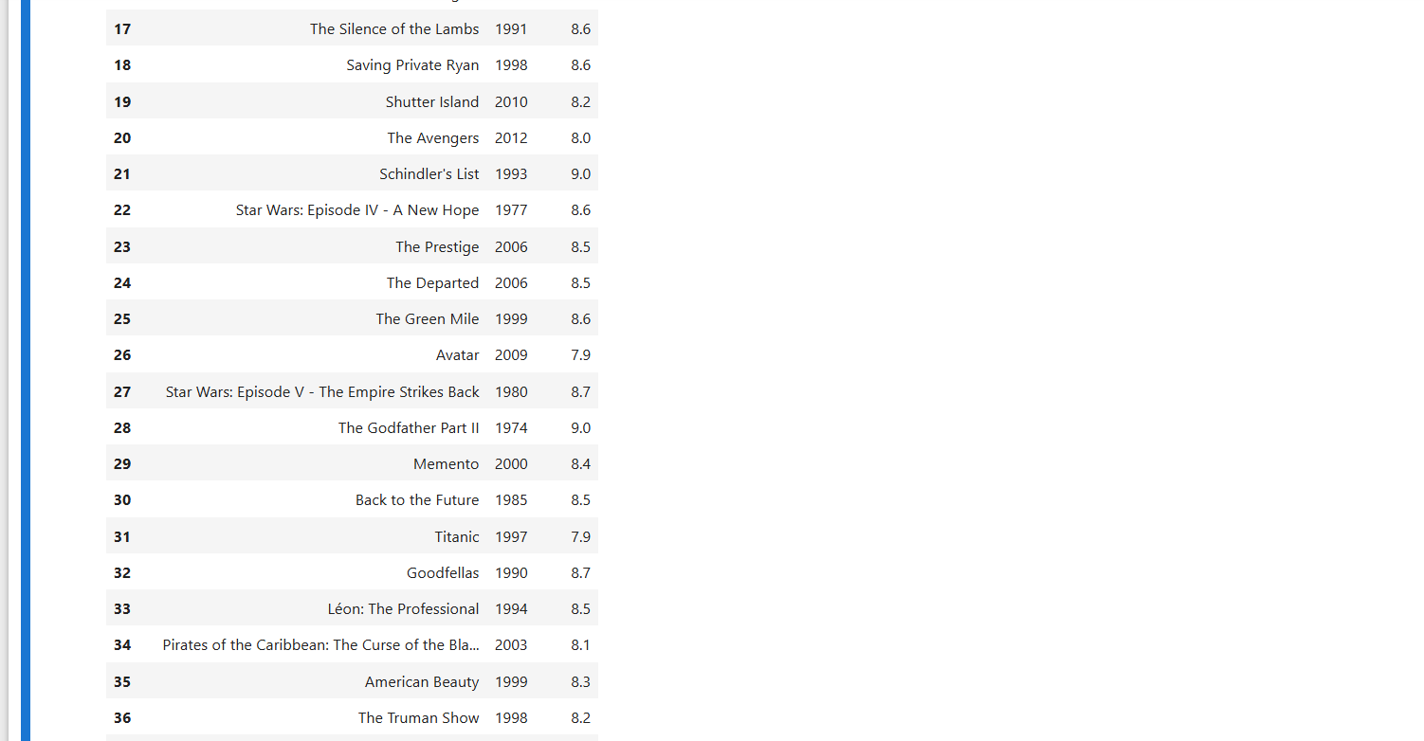

Slide 12
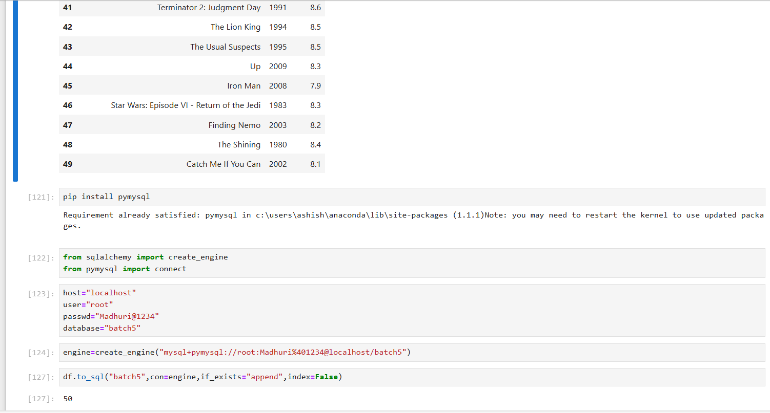
INSATLLING PYMYSQL THEN CONNECTING TO MYSQL

Slide 13
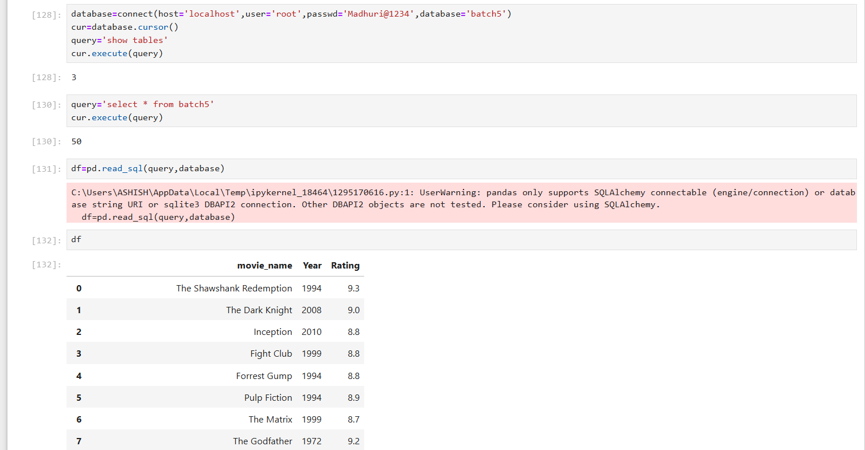
STORING DATA INTO MYSQL

Slide 14
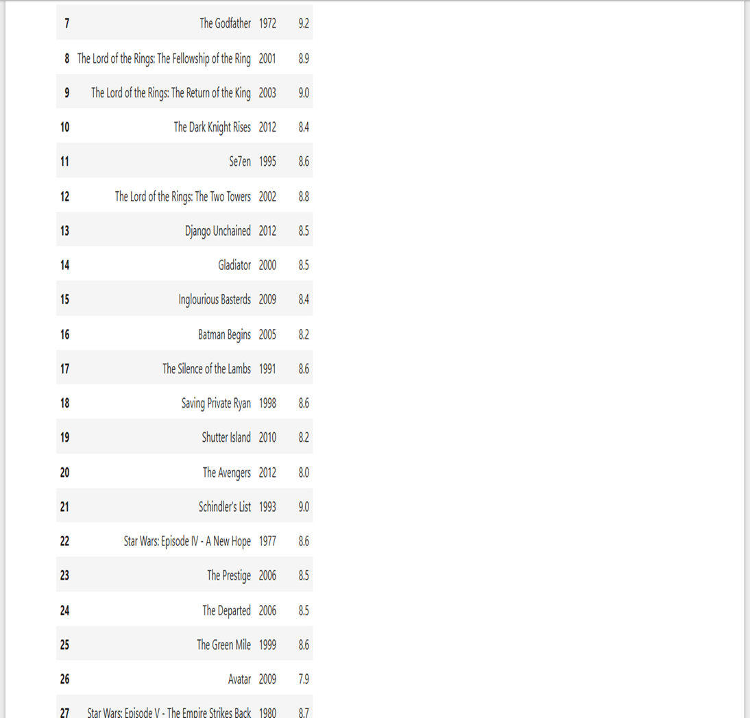


Slide 15
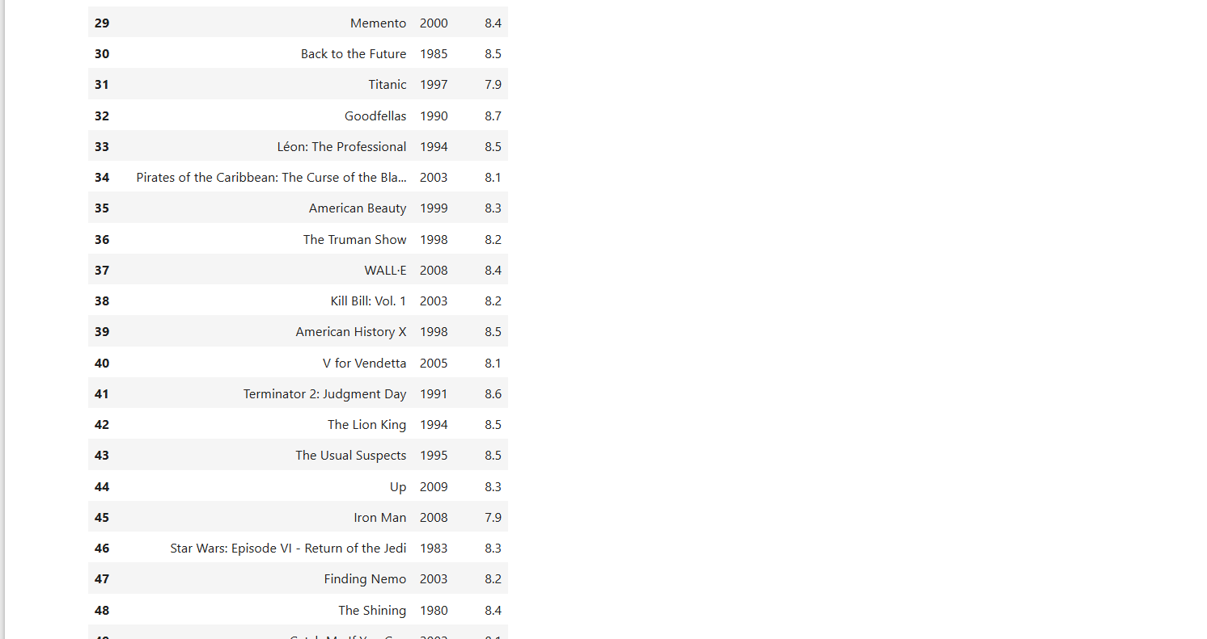


Slide 16
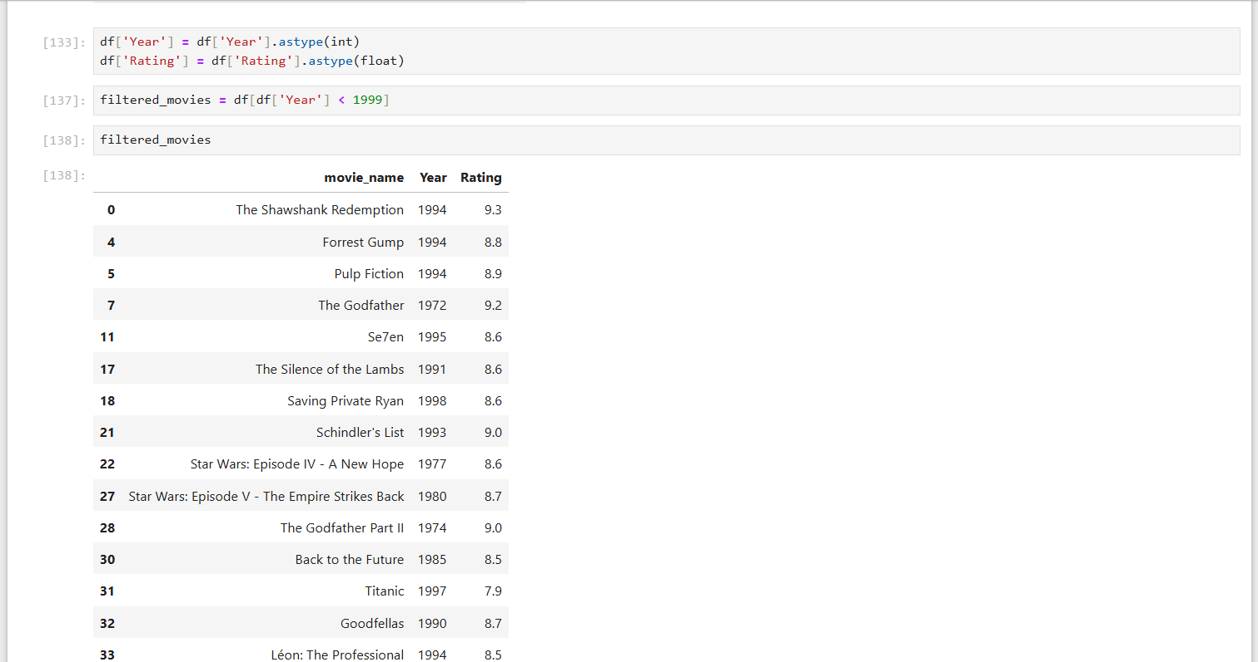
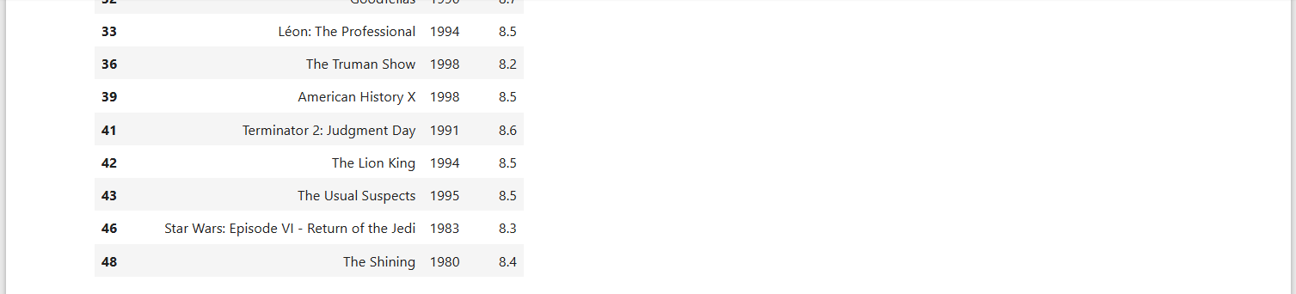
FILTERED YEAR AND RATING

Slide 17
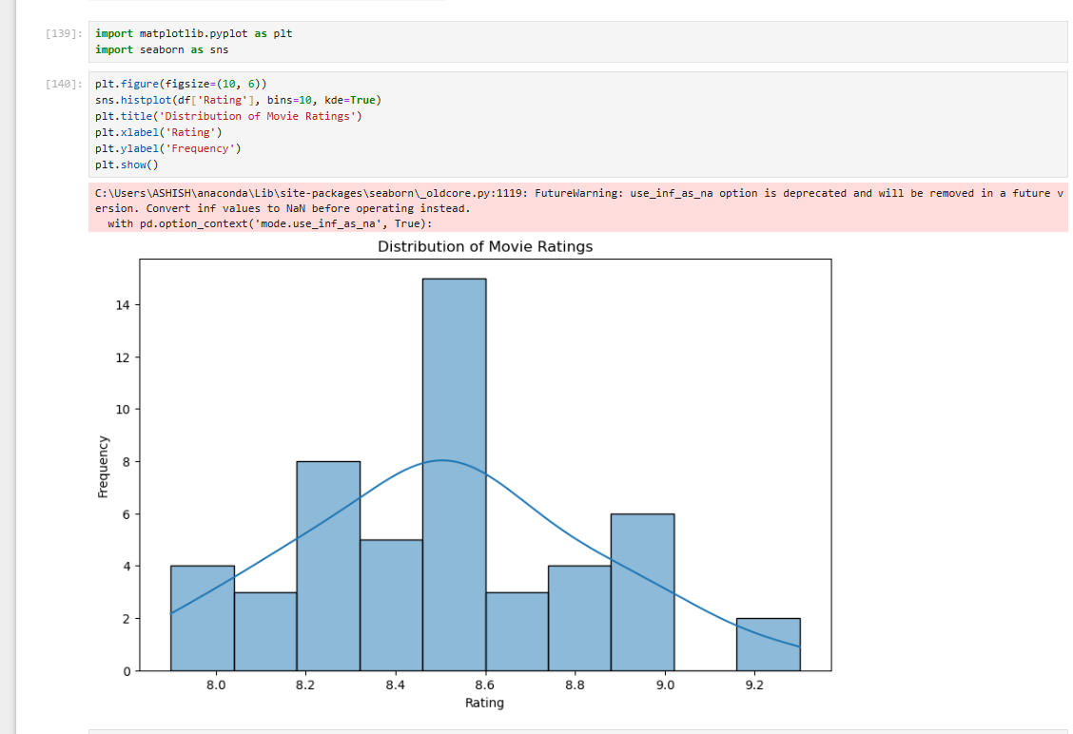
DATA VISUALISATION

Slide 18
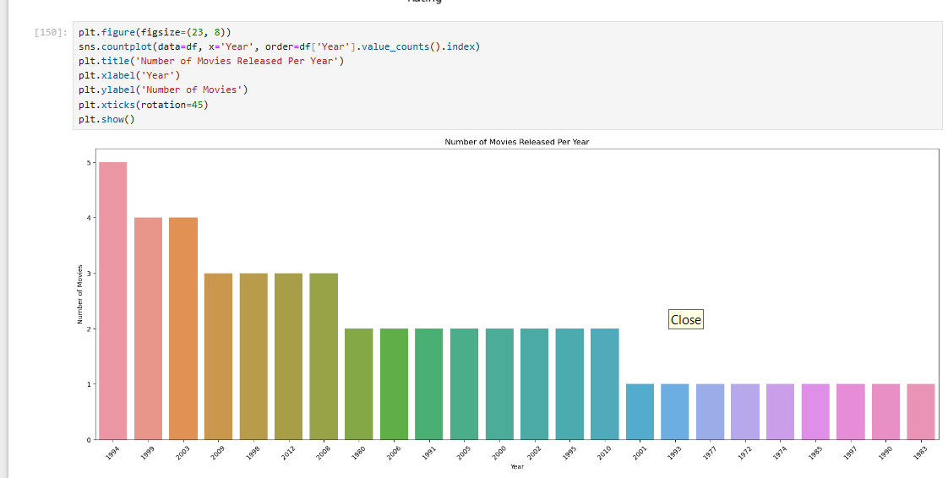
PLOT

Slide 19
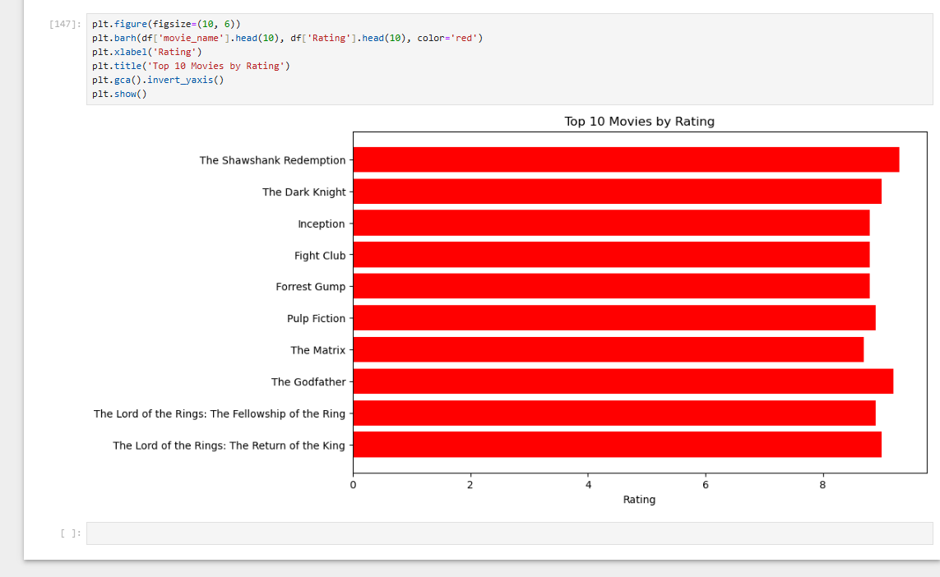
BAR GRAPH

Slide 20


